Slide 1
How We Performed:
2018 Occupational Injury & Fatality Data
Monday, April 13th 2020

Slide 2
Agenda
High level BLS Info
Non-fatal Occupational Injuries (Private)
Fatal Occupational Injuries
OSHA
COVID-19 Resources

Slide 3
Today’s speakers
RELEVANT EXPERIENCE
Eric Glass
Senior Risk & Safety Advisor
Eric.Glass@ul.com
Federated Insurance
Hazard Analysis: Performed hazard identification and analysis for national accounts with high self-insured retention programs
Program Development: Advised clients on program development based on hazards and exposures specific to their specific and industry exposure
Retail, service contractors, manufacturing, distribution, auto/equipment dealers (workers compensation, general liability, commercial auto/fleet, product liability_
Landrum-Yaeger & Associates
Risk Management: Developed risk management and insurance plans to ensure all operational risks were addressed and mitigated through risk control, risk financing or risk avoidance
United States Navy
Leadership: Trained, developed and lead explosive ordnance teams in high-hazard environments (aircraft carrier flight deck and weapons storage areas)
Delivery of EHS expertise throughout multiple UL business units
25 years in the risk management, loss control and safety industry.
Bachelor of Science: Risk Management & Insurance; Florida State University

Slide 4
High-Level BLS Data

Slide 5
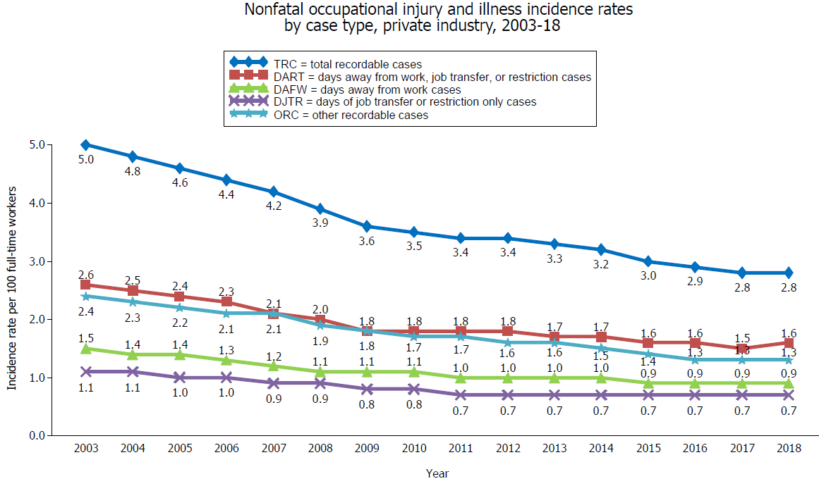
Notes:
The total recordable cases (TRC) incidence rate among private industry employers remained unchanged at 2.8 cases per 100 full-time workers in 2018. Even though the incidence rate for days away from work, job transfer, or restriction (DART) cases increased to 1.6 cases in 2018—up from 1.5 cases in 2017—the rates for days away from work (DAFW) cases and for days of job transfer or restriction only (DJTR) cases were unchanged. The rate for other recordable cases (ORC) cases also remained unchanged from 2017.

Slide 6
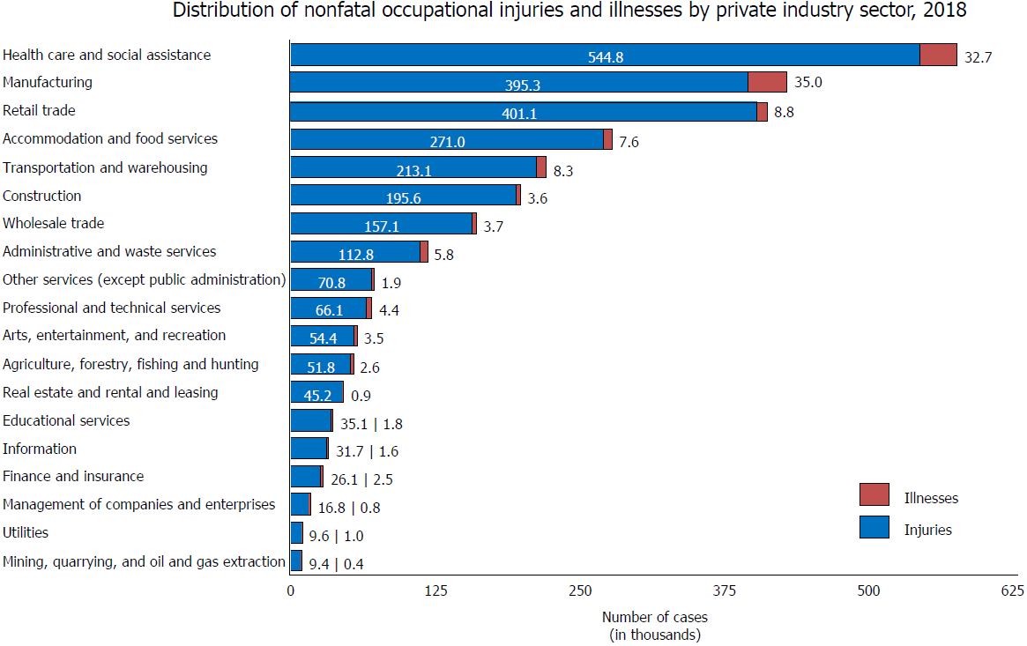
Notes:
Injuries accounted for 95 percent of cases reported among all private industry workplaces combined in 2018, as well as the majority of cases reported among individual industry sectors. Illnesses accounted for only a small fraction of cases reported in each industry sector.

Slide 7
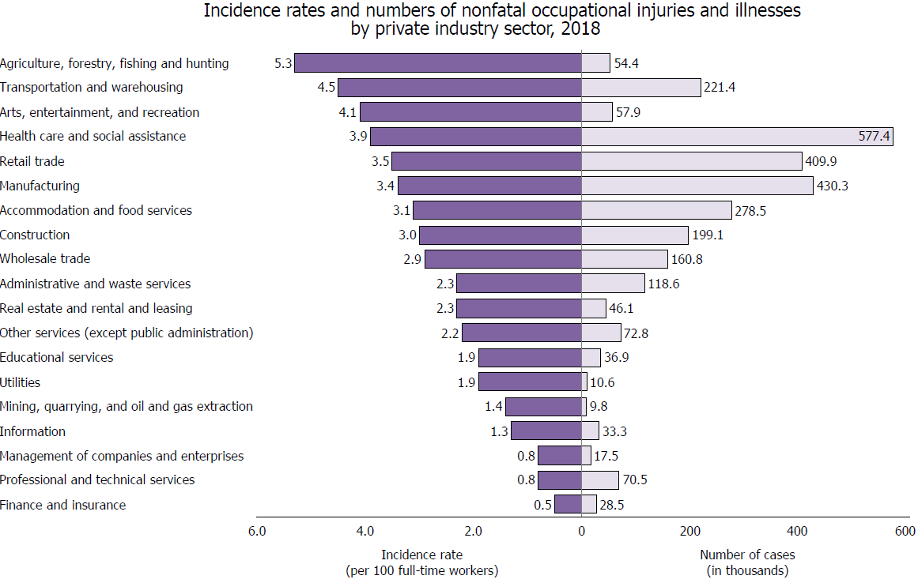
Notes:
The estimated rate of occupational injuries and illnesses across industry sectors ranged from 5.3 cases per 100 full-time workers in agriculture, forestry, fishing and hunting to 0.5 cases in finance and insurance. Health care and social assistance had the highest number of injuries and illnesses, accounting for approximately 1 in 5 injury and illness cases reported by private industry employers in 2018.

Slide 8
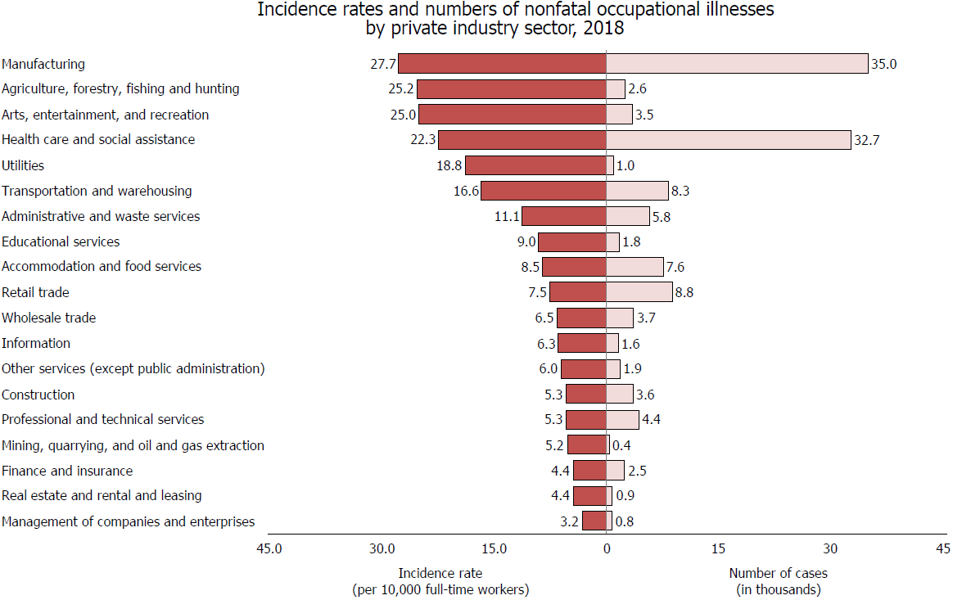
Notes:
The estimated rate of occupational illness across private industry was 12.6 cases per 10,000 full-time equivalent workers, with rates ranging among industry sectors from 3.2 cases in the management of companies and enterprises sector to 27.7 cases in manufacturing. The manufacturing and health care and social assistance industry sectors together reported 53.7 percent of all private industry illness cases in 2018.

Slide 9
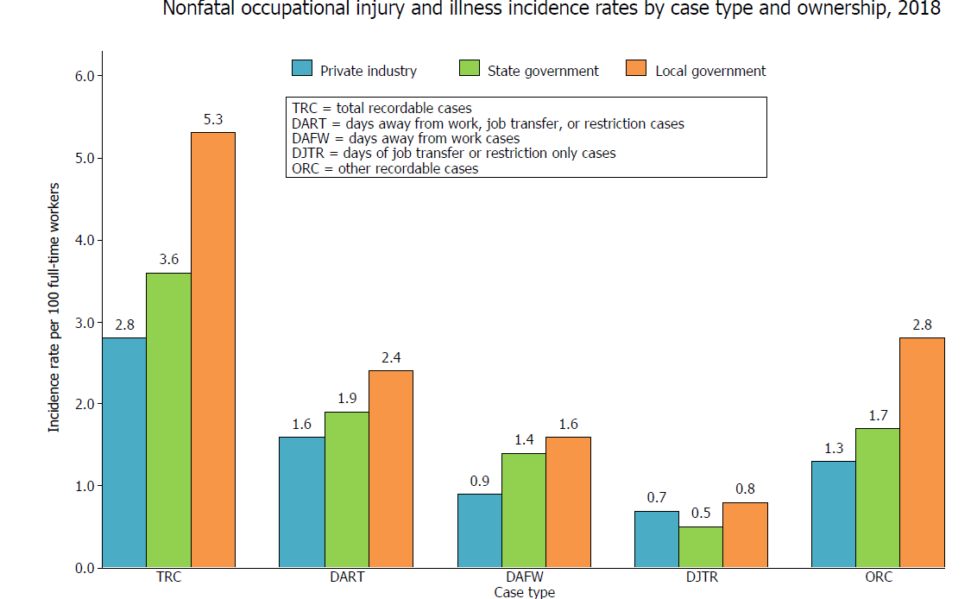
Notes:
Continuing a trend since 2008, the total recordable cases (TRC) incidence rate of injuries and illnesses remained highest among local government workplaces (5.3 cases per 100 full-time equivalent workers), compared to state government (3.6 cases) and private industry (2.8 cases) workplaces. The local government TRC rate increased from 5.0 cases in 2017 to 5.3 cases in 2018, while state government and private industry rates remained statistically unchanged.

Slide 10
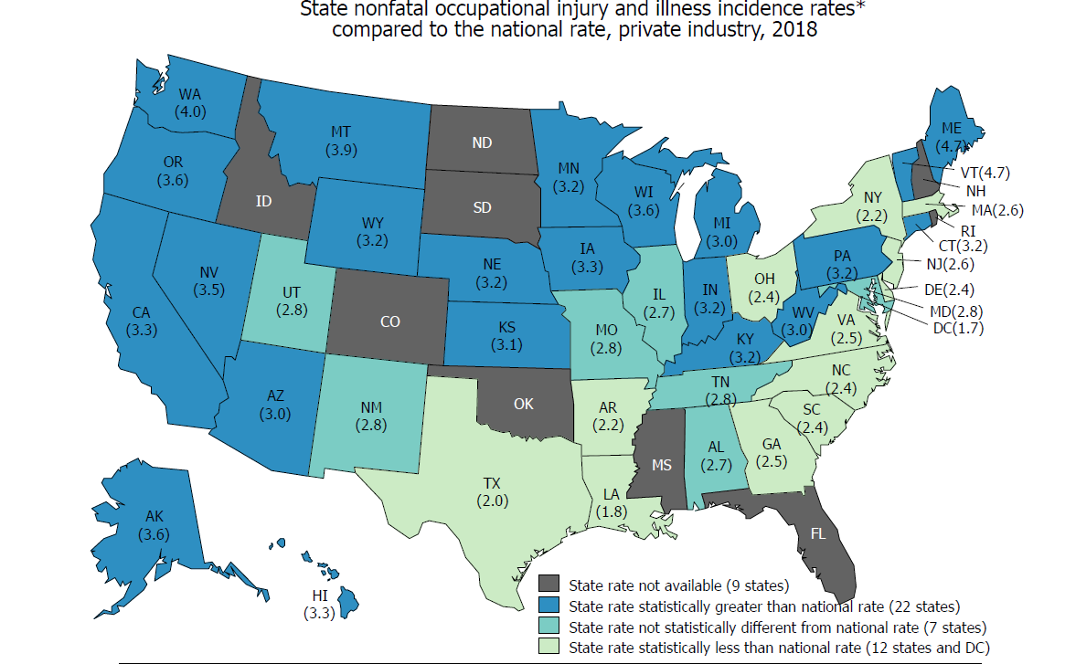
Notes:
Private industry and public sector estimates are available for 41 participating states and for the District of Columbia for 2018. The private industry and illness rate was higher in 22 states than the national rate of 2.8 cases per 100 full-time workers, lower in 12 states and in the District of Columbia, and not statistically different in 7 states. Caution should be taken when comparing rates among different states as some differences can be attributed to different industry composition within each state.

Slide 11
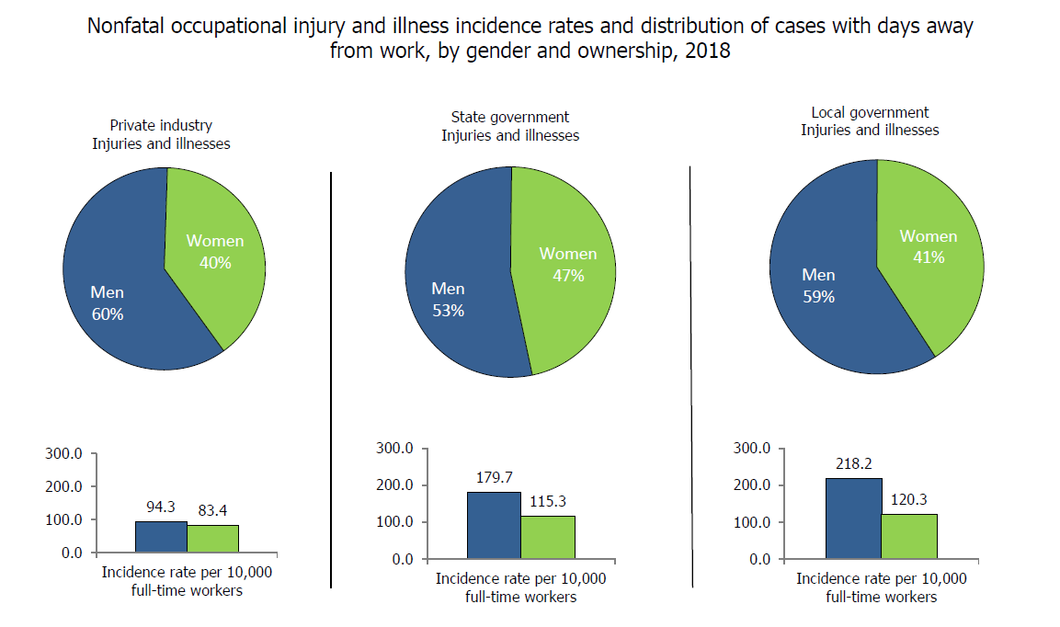
Notes:
The incidence rate of nonfatal occupational injuries and illnesses resulting in days away from work for women in private industry increased to 83.4 cases per 10,000 full-time workers in 2018, up from 81.5 in 2017. The rate for men in private industry was unchanged from 2017.

Slide 12
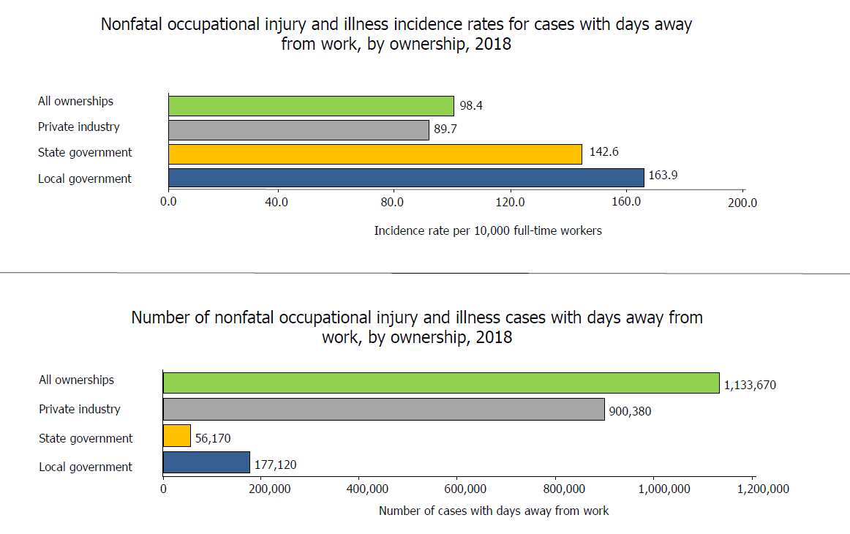
Notes:
Here is another way of looking at the incidence rates for days away from work so you can see where they are happening.
The incidence rates of nonfatal occupational injuries and illnesses resulting in days away from work for all ownerships was unchanged in 2018 from 2017. The rate for all ownerships decreased each year from 2011 through 2017.

Slide 13
Non-Fatal Occupational Injuries
(Private Sector)

Slide 14
Nature of Injury
Sprains Strains Tears (34%)
Soreness/Pain (18%)
Cuts Lacerations Punctures (10%)
Fractures (8%)
Bruise/Contusion
Notes:
Sprains, strains and tears have been a very consistent for the last decade. In fact, most of what you see here have appeared in the top 5, maybe just different positions within that Top 5

Slide 15
Part of Body
Trunk/Back (22%)
Upper Extremities (32%) Hand (43%)
Lower Extremities (24%) Knee (37%)
Multiple Body Parts (10%)
Head (9%) Eye (27%)
Notes:
Backs, hand and knee injuries remain on the most common body parts injured. Also, in the workers compensation world, these are probably the most expensive claim types as well that yield more days away from work and long recoveries.

Slide 16
Source of Injury
Floors, Walkways, Surfaces (16%)
Work Motion/Positioning (14%)
Other (12%)
Containers (12%)
Vehicles (11%)
Notes:
Floors walkways and surfaces have also remained as the most common source of injury of a number of years. Worker positioning and motions is a relative new comer. It slightly increases every year.

Slide 17
Event
Overexertion (31%) Lifting/Lowering (32%)
Slips, Trips, Falls (27%) Same Level (62%)
Contact With Object/Equipment (26%) Struck By (58%)
Transportation (6%)
Exposure to Hazardous Substance/Environments (4%)
Notes:
No real changes year over year from the event type. Lifting and lowering related injuries still top the list.

Slide 18
Fatal Occupational Injuries

Slide 19
5,250 (National: All Sectors)
100 per week / 14 per day
4,779 (Private)
Construction (1 of 5)
Georgia: 194
Fatal Occupational Injury Stats
Notes:
5250 fataliites occurred last year. 4,779 were in the private industry sector.
About 1 in 5 fatalities reporting were in the construction industry for all sectors.
In the State of Georgia, there were 194 reported workplace fatalities.

Slide 20
Transportation (40%)
1,276 (61%) On-Road
677 (53%) Vehicle/Vehicle
2nd: Violence (Person)
Transportation Events (2,080)
Notes:
Transportation is the most common fatality cause. 2080 (or 40%). 61 percent were on road related and a majority was vehicle on vehicle.
Noteable 2nd, Violence caused by another person.

Slide 21
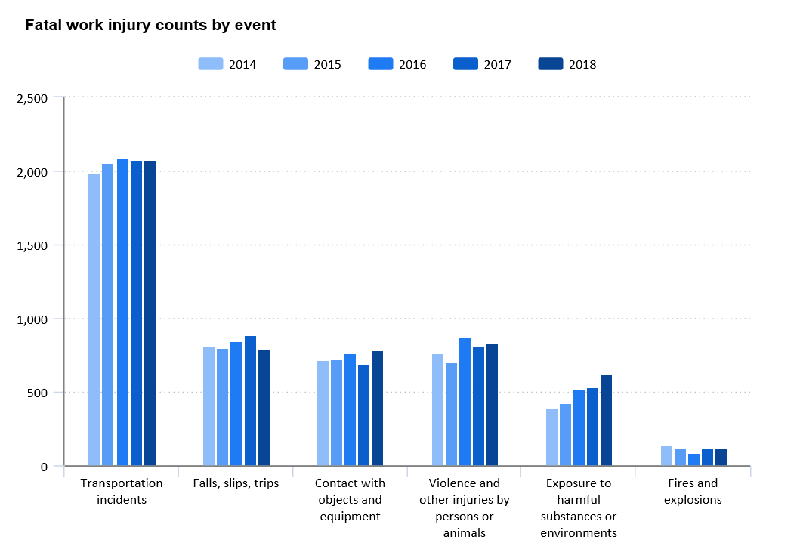
Notes:
Transportation has remained the top workplace fatality event since 2014, and even prior to that.

Slide 22
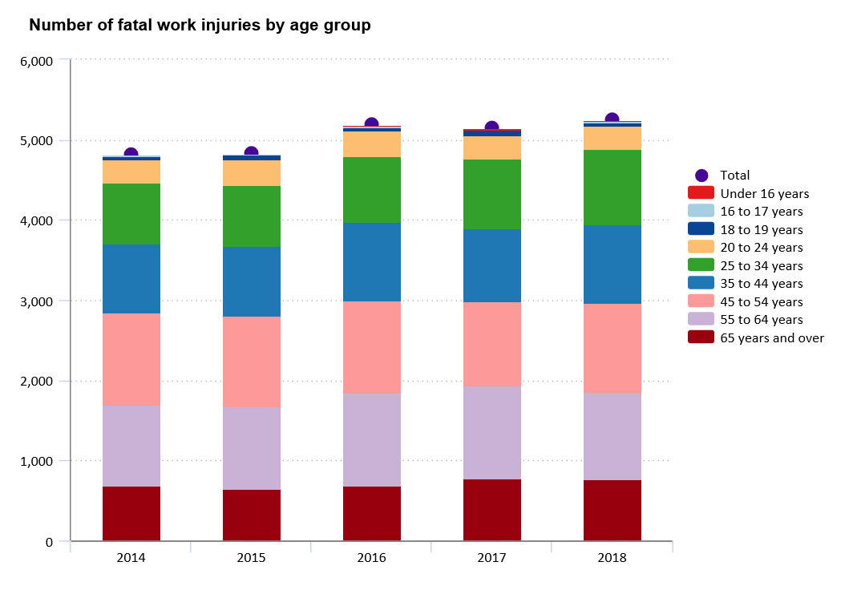

Slide 23
OSHA: 2018 Information

Slide 24
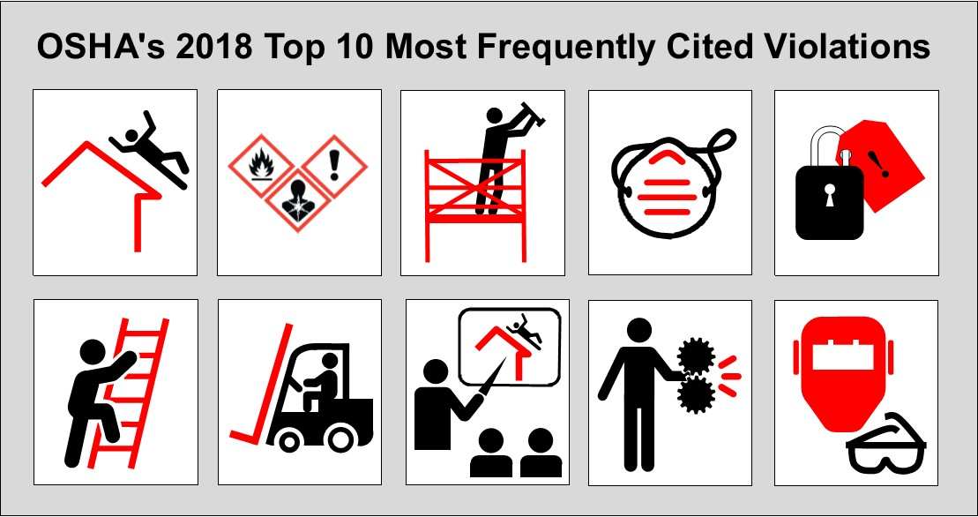
Notes:
Fall protection, construction (29 CFR 1926.501) [related OSHA Safety and Health Topics page]
Hazard communication standard, general industry (29 CFR 1910.1200) [related OSHA Safety and Health Topics page]]
Scaffolding, general requirements, construction (29 CFR 1926.451) [related OSHA Safety and Health Topics page]
Respiratory protection, general industry (29 CFR 1910.134) [related OSHA Safety and Health Topics page]
Control of hazardous energy (lockout/tagout), general industry (29 CFR 1910.147) [related OSHA Safety and Health Topics page]
Ladders, construction (29 CFR 1926.1053) [related OSHA Safety and Health Topics page]
Powered industrial trucks, general industry (29 CFR 1910.178) [related OSHA Safety and Health Topics page]
Fall Protection–Training Requirements (29 CFR 1926.503) [related OSHA Safety and Health Topics page]
Machinery and Machine Guarding, general requirements (29 CFR 1910.212) [related OSHA Safety and Health Topics page]
Eye and Face Protection (29 CFR 1926.102) [related OSHA Safety and Health Topics page

Slide 25
VIOLATIONS (#)
10. Eye and Face Protection: 1926.102, (1,536) 9. Machine Guarding: 1926.212, (1,972) violations 8. Fall Protection—Training Requirements: 1926.503,(1,982) 7. Powered Industrial Trucks: 1910.178 (2,294) 6. Ladders: 1926.1053, (2,812) 5. Lockout/Tagout: 1910.147 (2,944) 4. Respiratory Protection: 1910.134 (3,118) 3. Scaffolds—General Requirements: 1926.451 (3,336) 2. Hazard Communication: 1910.1200 (4,552) 1. Fall Protection—General Requirements: 1926.501 (7,720)

Slide 26
COVID-19 Resources

Slide 27
Communication/Resources
AGENCIES:
Centers for Disease Control (CDC)
World Health Organization (WHO)
National Institutes of Health (NIH)
COVID-19 RESOURCES:
COVID-19 Business Response
COVID-19 Main Page (CDC)
COVID-19 Main Page (OSHA)
Guidance for Businesses/Employers (CDC)
Guidelines for America (WH.gov)
Frequently Asked Questions (CDC)
High Risk Individuals (CDC)
International & Domestic Travel (CDC)
PRINTABLE RESOURCES:
COVID-19 Graphics/Images (CDC)
COVID-19 Guidelines for America (WH.gov)
Guidance for Preparing Workplaces (OSHA)
Share the Facts (CDC)
Stopping the Spread of Germs PDF (CDC)
Symptoms PDF (CDC)
What To Do If Sick (CDC)
What You Need To Know (CDC)
10 Things: Possible/Confirmed PDF (CDC)
Click HERE to register for COVID-19 updates from the CDC (bottom left of page)

Slide 28
Free Course Access
Infection Control – Handwashing
Coronavirus Disease 2019
Pandemic and Influenza
Click here to access free Pandemic Awareness courses

Slide 29
Questions?
Contact Us:
NAME: Eric Glass
EMAIL: Eric.Glass@ul.com

Slide 30
Thank you

